Slide 1
Java & JEE Fast Track Training Handling Arrays and Strings in Java

Slide 2
Java & JEE Fast Track Training – Day 3 Agenda
Quick review of last class
Autoboxing and Unboxing in Java
Handling Arrays
Memory Allocation and Garbage Collection
String Manipulation

Slide 3
Quick review of last class

Slide 4
Java & JEE Fast Track Training – Day 3 Agenda
Quick review of last class
Autoboxing and Unboxing in Java
Handling Arrays
Memory Allocation and Garbage Collection
String Manipulation

Slide 5
Autoboxing and Unboxing in Java

Slide 6
Autoboxing and Unboxing in Java
Autoboxing is the automatic conversion that the Java compiler makes between the primitive types and their corresponding object wrapper classes. For example, converting an int to an Integer, a double to a Double, and so on.
If the conversion goes the other way, this is called unboxing.
Introduced in JDK 5

Slide 7
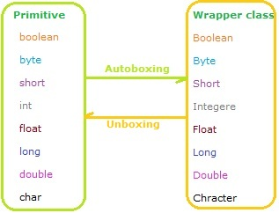
Autoboxing and Unboxing in Java

Slide 8
Java & JEE Fast Track Training – Day 3 Agenda
Quick review of last class
Autoboxing and Unboxing in Java
Handling Arrays
Memory Allocation and Garbage Collection
String Manipulation

Slide 9
Handling Arrays

Slide 10
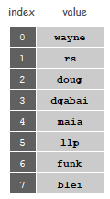
Arrays
We need a way to store and manipulate huge quantities of data.
“An array is an indexed sequence of values of the same type.”
Examples.
52 playing cards in a deck.
5 thousand undergrads at Princeton.
1 million characters in a book.
10 million audio samples in an MP3 file.
4 billion nucleotides in a DNA strand.
73 billion Google queries per year.
50 trillion cells in the human body.

Slide 11
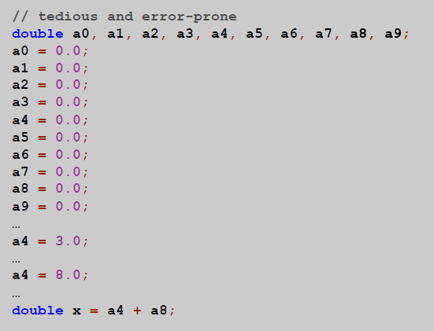
Goal: Many variables of the same type

Slide 12
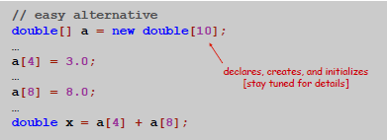
Goal: Many variables of the same type

Slide 13

Arrays in Java
Java has special language support for arrays.
To make an array: declare, create, and initialize it.
To access element i of array named a, use a[i].
Array indices start at 0.
Compact alternative.
Declare, create, and initialize in one statement.
Default initialization: all numbers automatically set to zero.

Slide 14


Declaring Arrays – Two ways

Slide 15
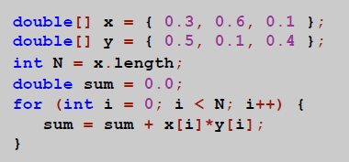
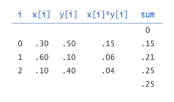
Exercise: Vector dot product
Dot product. Given two vectors x[] and y[] of length N, their dot product is the sum of the products of their corresponding components.

Slide 16
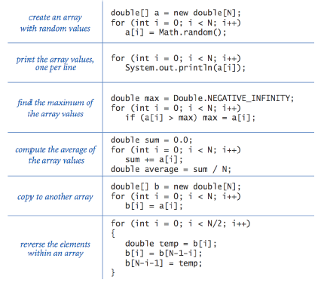
Array Processing Examples

Slide 17
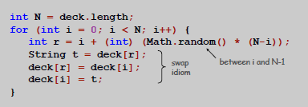
Example: Card shuffling algorithm
Goal. Given an array, rearrange its elements in random order.
Shuffling algorithm.
In iteration i, pick random card from deck[i] through deck[N-1], with each card equally likely.
Exchange it with deck[i].

Slide 18
Two Dimensional Arrays
Two-dimensional arrays.
Table of data for each experiment and outcome.
Table of grades for each student and assignments.
Table of grayscale values for each pixel in a 2D image.
Mathematical abstraction. Matrix.
Java abstraction. 2D array.

Slide 19
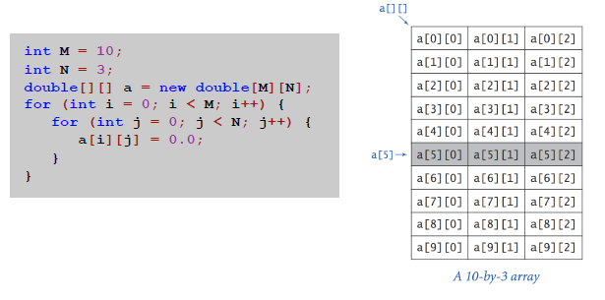
Two Dimensional Arrays in Java
Array access. Use a[i][j] to access element in row i and column j.
Zero-based indexing. Row and column indices start at 0.
a[i] is the i’th row, which is a one dimensional array here.

Slide 20
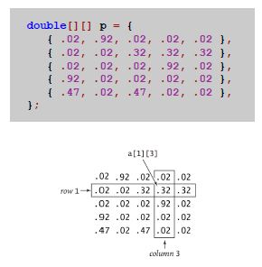
Initialize 2D array : Inline initialization

Slide 21
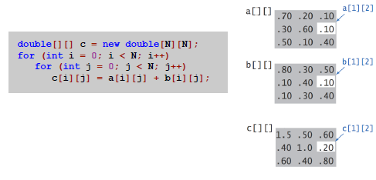
Example: Matrix Addition

Slide 22
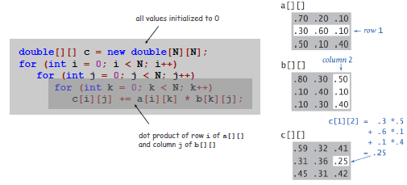
Example: Matrix Multiplication

Slide 23
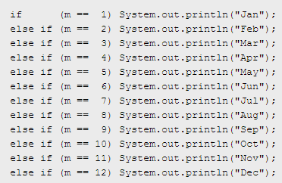
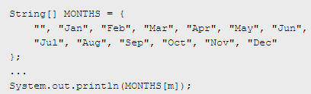
Example: Using arrays to simplify repetitive code

Slide 24
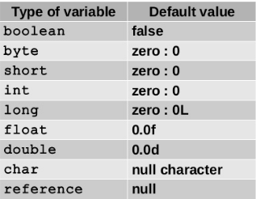
Default Initialization: Class / instance variable & Arrays
Each class variable, instance variable, or array component is initialized with a default value when it is created:

Slide 25
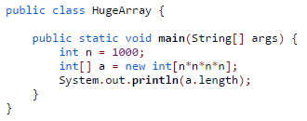
Exercise: What is the output? Why?

Slide 26
Exercise: What is the output? Why?
Attempts to create an array of size n^4 for n = 1000.
This program compiles cleans.
When n is 1000, it leads to the following error
java.lang.NegativeArraySizeException
because 1000^4 overflows an int and results in a negative integer.
When n is 200, it leads to the following error
java.lang.OutOfMemoryError: Requested array size exceeds VM limit

Slide 27

Exercise: What is the output?
What is wrong with the following code fragment?

Slide 28
Exercise: What is the output?
What is wrong with the following code fragment?
It does not allocate memory for a[] with new. The code results in a variable might not have been initialized compile-time error.

Slide 29

Exercise: What is the output?

Slide 30
Exercise: What is the output?
It prints false. The == operator compares whether the (memory addresses of the) two arrays are identical, not whether their corresponding values are equal.

Slide 31
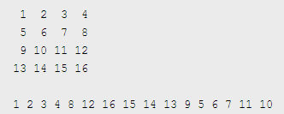
Exercise: Print elements of a matrix in spiral order
Given a 2-D array, write a program Spiral.java to print it out in spiral order.

Slide 32
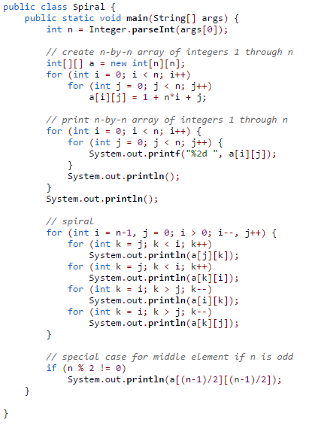
Exercise: Print elements of a matrix in spiral order: Solution

Slide 33
What is the output?
What happens when you try to compile a program with the following statement?
int[] a = new int[-17];

Slide 34
What is the output?
What happens when you try to compile a program with the following statement?
int[] a = new int[-17];
It compiles cleanly, but throws a java.lang.NegativeArraySizeException when you execute it.

Slide 35

What is the output?
Suppose that b[] is an array of 100 elements, with all entries initialized to 0, and that a[] is an array of N elements, each of which is an integer between 0 and 99. What is the effect of the following loop?

Slide 36
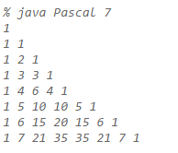
Exercise: Pascal’s triangle
Write a program Pascal.java to compute Pascal's triangle using a ragged array.

Slide 37
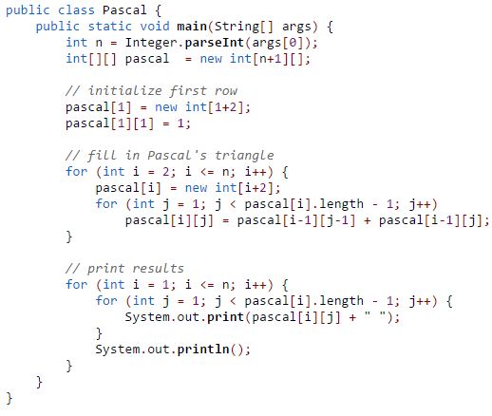
Exercise: Pascal’s triangle - Solution
Write a program Pascal.java to compute Pascal's triangle using a ragged array.

Slide 38
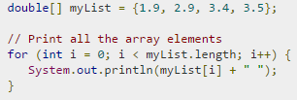
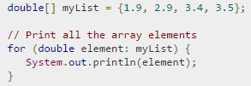
Iterating through elements in an Array – Two ways
for Loop
foreach Loop (introduced in Java 1.5)

Slide 39
Java & JEE Fast Track Training – Day 3 Agenda
Quick review of last class
Autoboxing and Unboxing in Java
Handling Arrays
Memory Allocation and Garbage Collection
String Manipulation

Slide 40
Memory Allocation & Garbage Collection

Slide 41
Memory Allocation in Java and Garbage Collection
Java Heap Space
Used by Java runtime to allocate memory to Objects and JRE classes.
Any new Object is always created in Heap Space.
Garbage Collection runs on the heap memory to free the memory used by objects that doesn’t have any reference.
All instance and class variables are also stored in the heap.
Java Stack Memory
Used for execution of a thread.
Store method specific values, and “references” to Objects being used in the method.
Stack memory is LIFO (Last-In-First-Out)
Whenever a method is invoked, a new block is created in the stack memory for the method to hold local primitive values and reference to other objects in the method. As soon as method ends, the block becomes unused and become available for next method.
Stack memory size is very less compared to Heap memory.

Slide 42
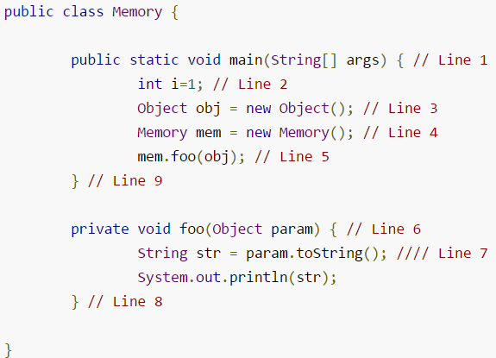
Memory Allocation in Java and Garbage Collection

Slide 43
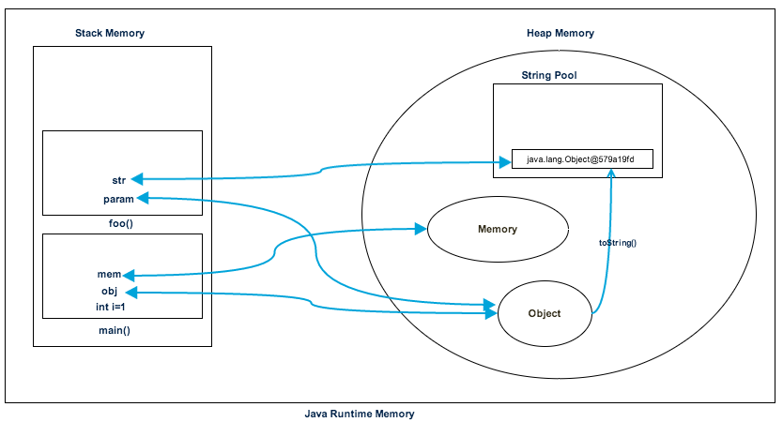
Memory Allocation in Java and Garbage Collection

Slide 44
Java & JEE Fast Track Training – Day 3 Agenda
Quick review of last class
Autoboxing and Unboxing in Java
Handling Arrays
Memory Allocation and Garbage Collection
String Manipulation

Slide 45
Strings in Java

Slide 46


Creating String in Java
There are two ways to create a String in Java
String literal
Using “new” keyword
Does it make any difference? Well, yes!

Slide 47
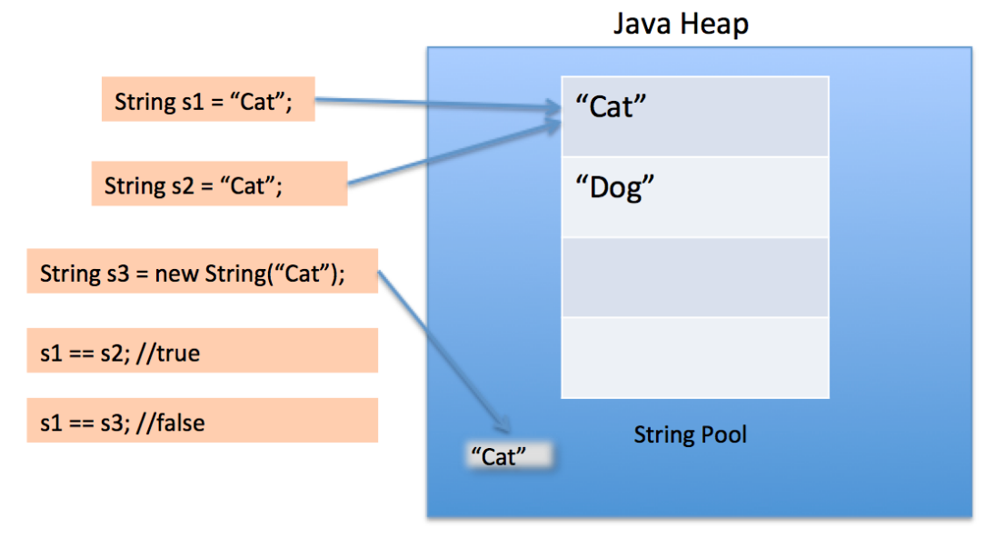
String Pool Concept in Java (String Interning)
String Intern Pool maintained in Java Heap Space

Slide 48
String Pool Concept in Java (String Interning)
String is immutable in Java
All Strings are stored in String Pool (also called String Intern Pool) allocated within Java Heap Space
It is implementation of String Interning Concept.
String interning is a method of storing only one copy of each distinct string value, which must be immutable.
Interning strings makes some string processing tasks more time- or space-efficient at the cost of requiring more time when the string is created or interned.
The distinct values are stored in a string intern pool.
String pool is an example of Flyweight Design Pattern.
Using new operator, we force String class to create a new String object in heap space.

Slide 49

Discussion: How many Strings are getting created here?

Slide 50
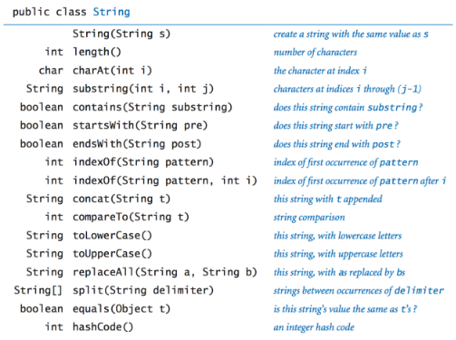
java.lang.String API – Important methods

Slide 51
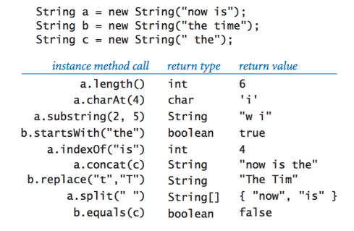
java.lang.String API – Examples

Slide 52
Converting String to numbers and vice versa
String to Number int i = Intege­r.p­ars­eIn­t(­str);
Integer i = Integer.valueOf(str);
double d = Double.pa­rse­Dou­ble­(s­tr);
Double d = Double.valueOf(str);
Note: Both throw NumberFormatException If the String is not valid for conversion
String to Boolean
boolean b = Boolean.parseBoolean(str);
Any Type to String
String s = String.va­lue­Of(­va­lue);

Slide 53
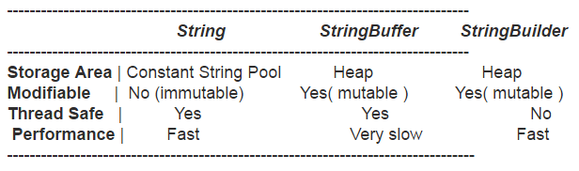
String vs StringBuffer/StringBuilder
Prefer StringBuffer or StringBuilder when performing multiple concatenations in your code.

Slide 54
Exercise: What is the output?
public static String someMethod( String str)
{
if( str == null)
return null;
int len = str.length();
for( ; len > 0; len--)
{
if( ! Character.isWhitespace( str.charAt( len - 1)))
break;
}
return str.substring( 0, len);
}

Slide 55
Exercise
Write a program to input 2 strings – string1 and string2, and concatenate the first 5 characters of string1 with last 5 characters of string2.

Slide 56
Exercise
Write a program to input 3 strings and check if at least any two strings are equal.

Slide 57
Exercise
Write a program to sort an array of Strings in ascending order.

